Slide 1

Bulgaria - destination for all seasons
AVATAR TOUR LTD website: www.avatartour.bg, e-mail: incoming@avatartour.bg

Slide 2

Avatar Tour LTD is operational since 2011 and is a licensed company for travel and tourism and one of the most dynamically developing tour operators in Bulgaria.
The management team of the company consists of very experienced people working in the industry for more than 20 years. Under their leadership works a young, educated and enthusiastic team which takes care of every partner and client with great attention.
AVATAR TOUR LTD website: www.avatartour.bg, e-mail: incoming@avatartour.bg

Slide 3
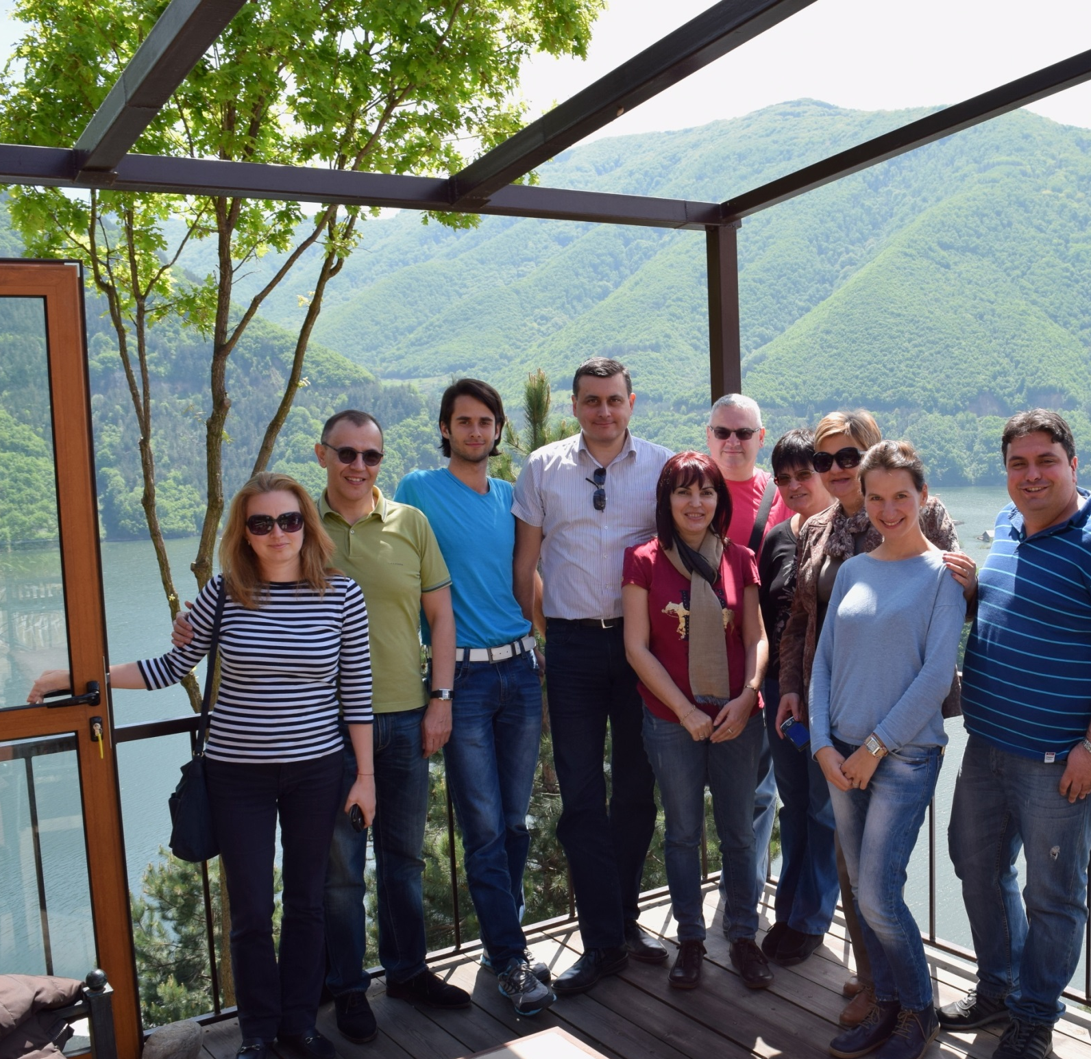
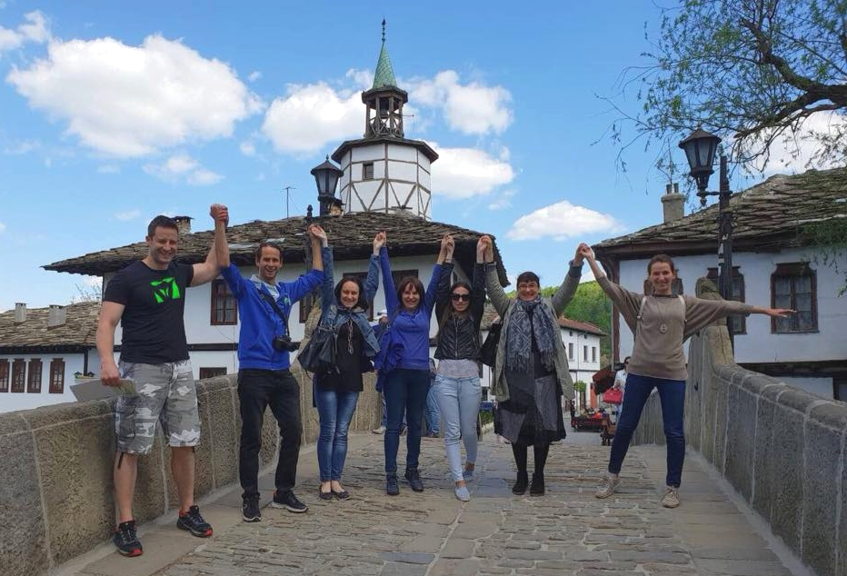
Our team!

Slide 4
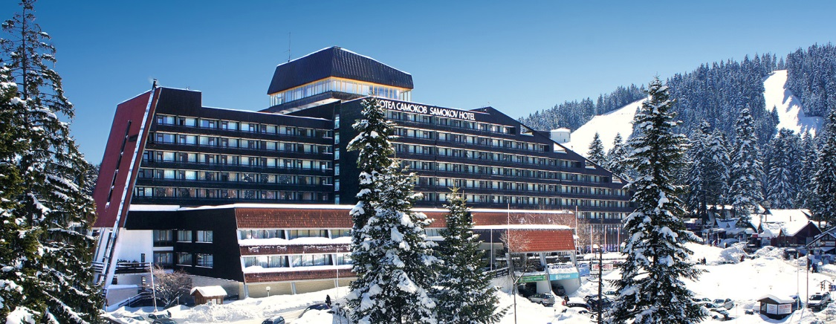
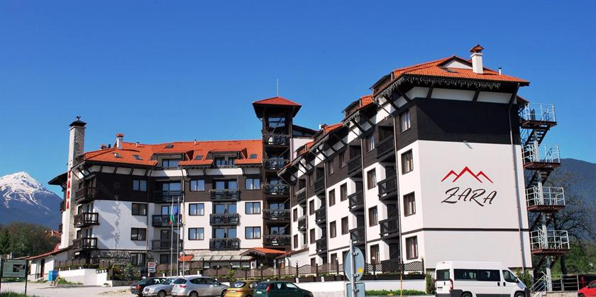
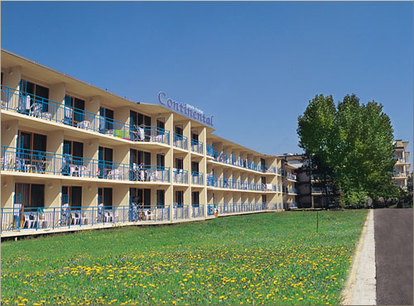
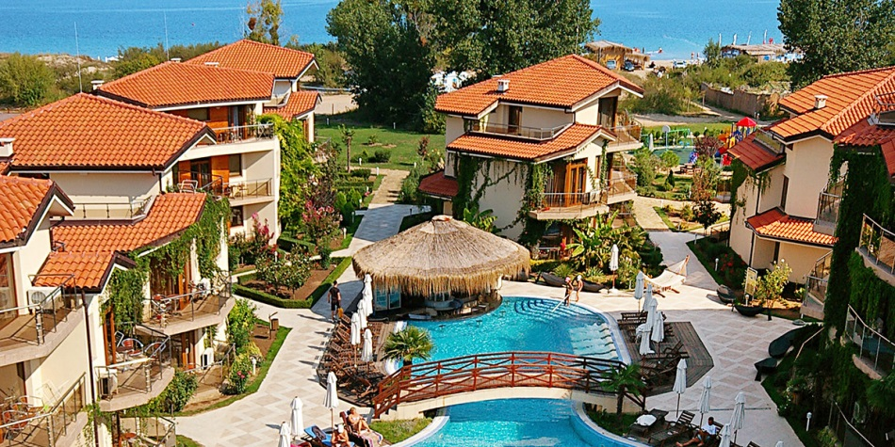
Two of our main shareholders own some of the most popular holiday hotels in Bulgaria:
Samokov 4* in the famous mountain & ski resort Borovets,
Zara hotel & Spa in Bansko ski resort and
two hotels on our Black Sea coast - Park-hotel Continental 3*+ in Sunny Beach and Laguna Beach 4* in Sozopol.
AVATAR TOUR LTD website: www.avatartour.bg, e-mail: incoming@avatartour.bg

Slide 5
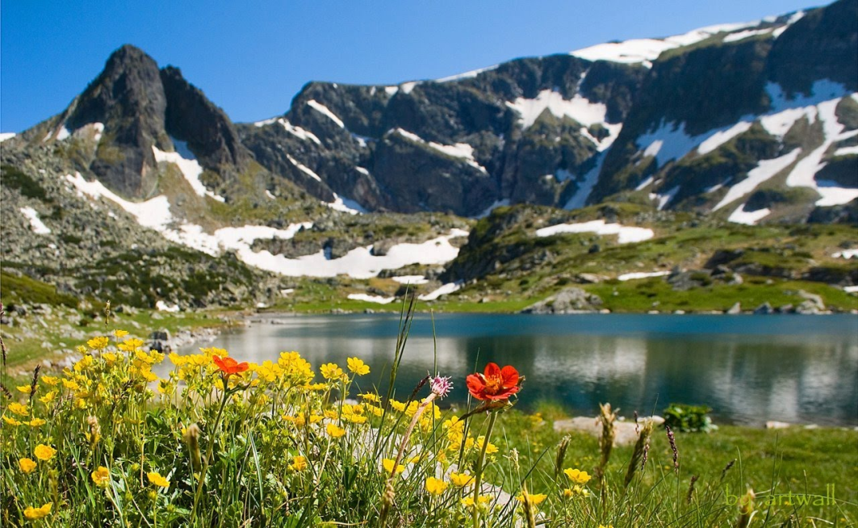
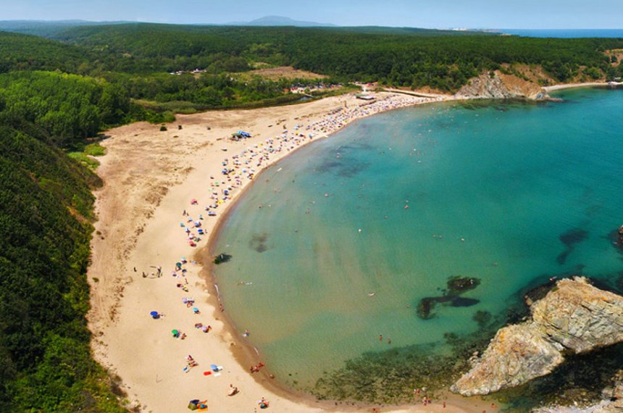
Our company is DMC for Bulgaria and the Balkans!
The product range includes:
Holidays in the Bulgarian Black sea and winter resorts for groups & individuals
Full range of offers for SPA & Balneology hotels
Round tours in Bulgaria, Balkan peninsula tours
Fly & Drive and Adventure programs
City breaks
Transfers
MICE
Air-tickets
Insurances
Rent-a-car
AVATAR TOUR LTD website: www.avatartour.bg, e-mail: incoming@avatartour.bg

Slide 6
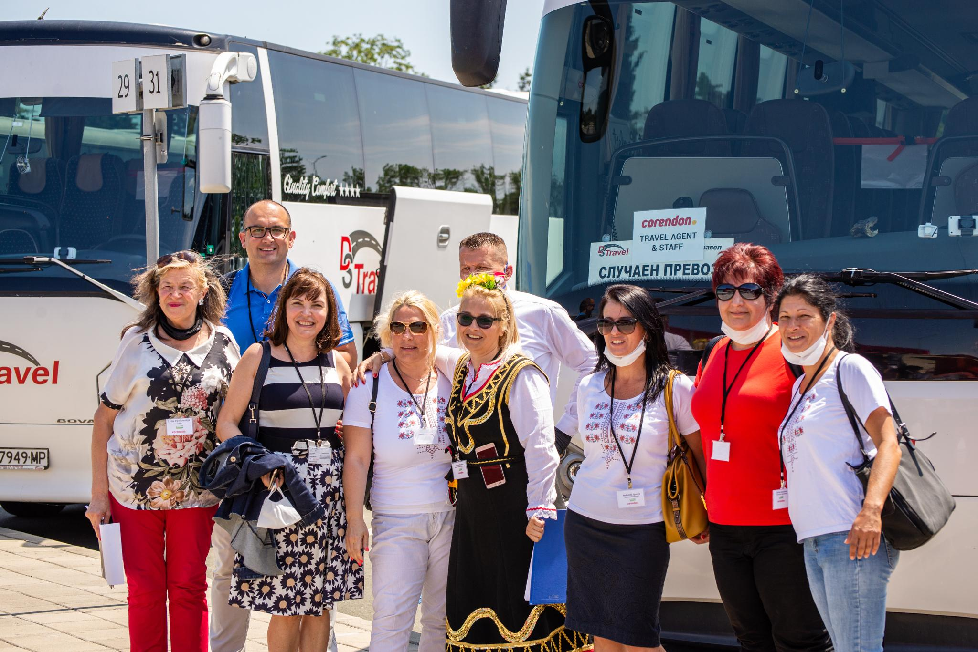
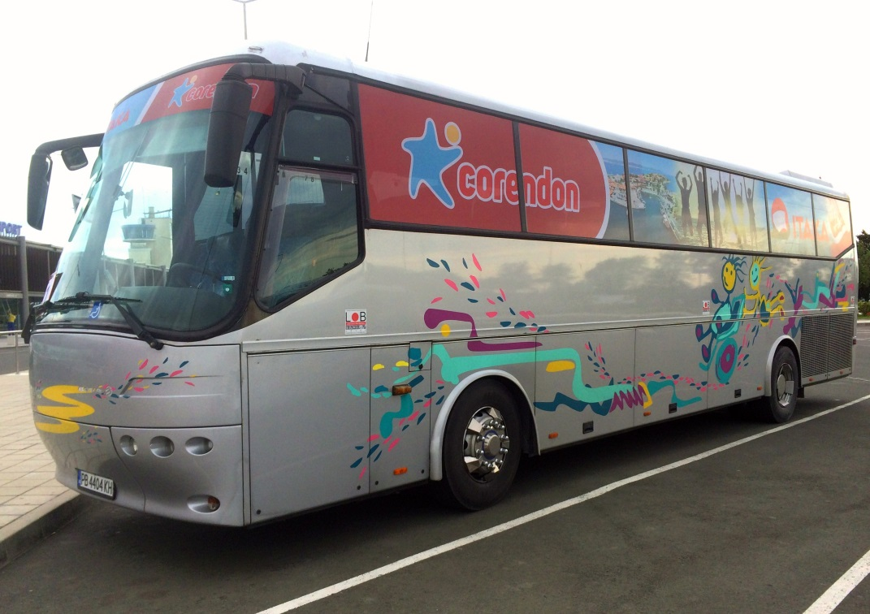
Our main markets and partners:
Beach and Ski holidays:
Holland & Belgium –Corendon Touristic & GOFUN
Poland – Nowa Itaka and Czech Republic – Cedok during the period 2013-2019.
individual clients and groups from Israel, Belarus, Baltic States, as well as from the regional markets – North Macedonia, Serbia, Romania, Moldova, Kosovo, Albania.
Round trips:
STIP REIZEN – Holland
AVATAR TOUR LTD website: www.avatartour.bg, e-mail: incoming@avatartour.bg

Slide 7
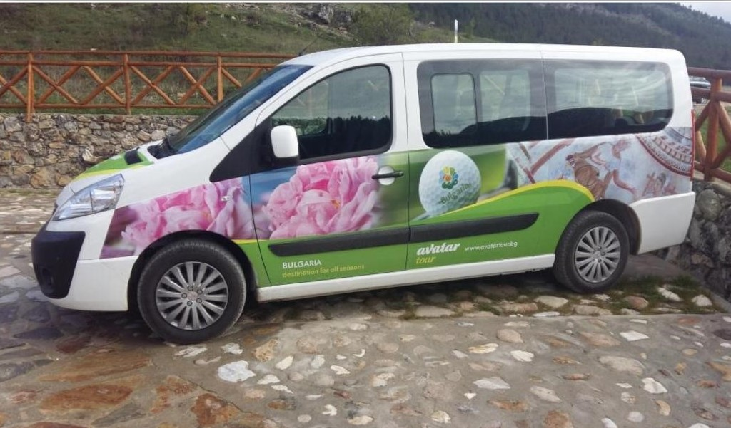
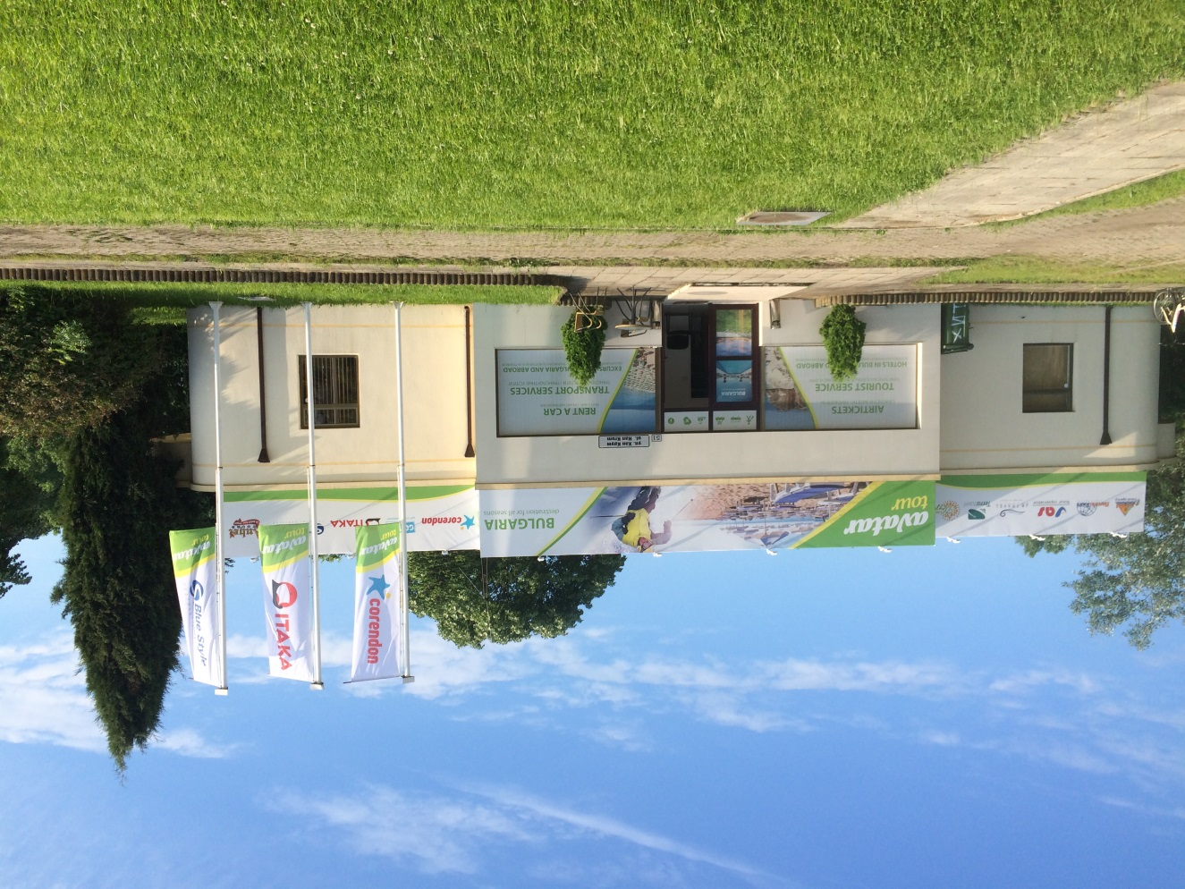
Number of serviced tourists 2018: 65 000 pax
Number of serviced tourists 2019: 75 000 pax
We are carrying out our main business from the central offices in Sofia and Varna, and during the summer seasons we have a resort office at the sea side resort of Sunny Beach.
AVATAR TOUR LTD website: www.avatartour.bg, e-mail: incoming@avatartour.bg

Slide 8
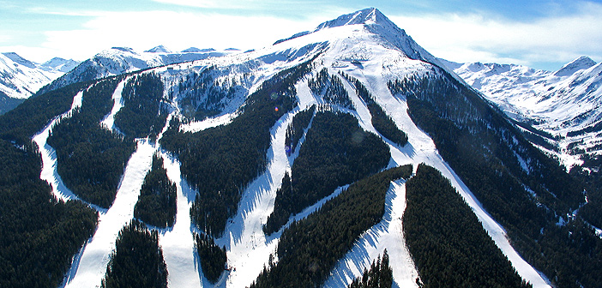
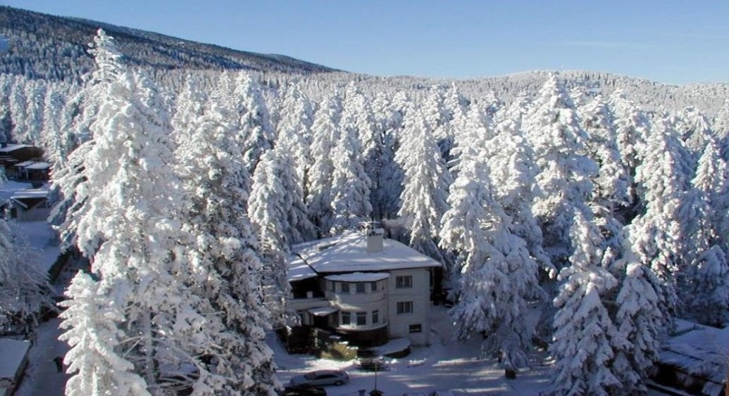
During the winter time, we have representatives in Borovets, Bansko and Pamporovo, so all our customers can benefit from the services we provide on the spot.
We also offer a variety of different excursions our clients can choose from during their stay.
AVATAR TOUR LTD website: www.avatartour.bg, e-mail: incoming@avatartour.bg

Slide 9
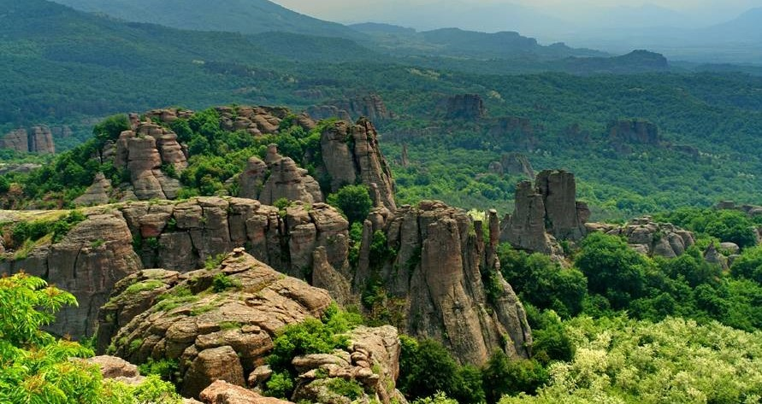
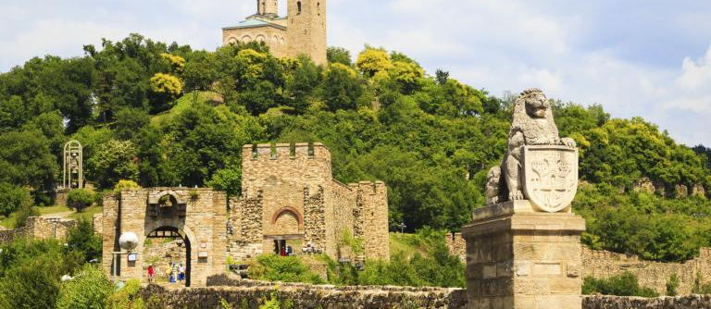
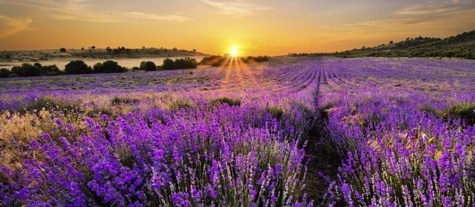
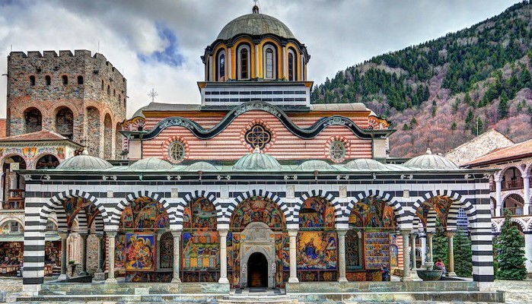

Slide 10
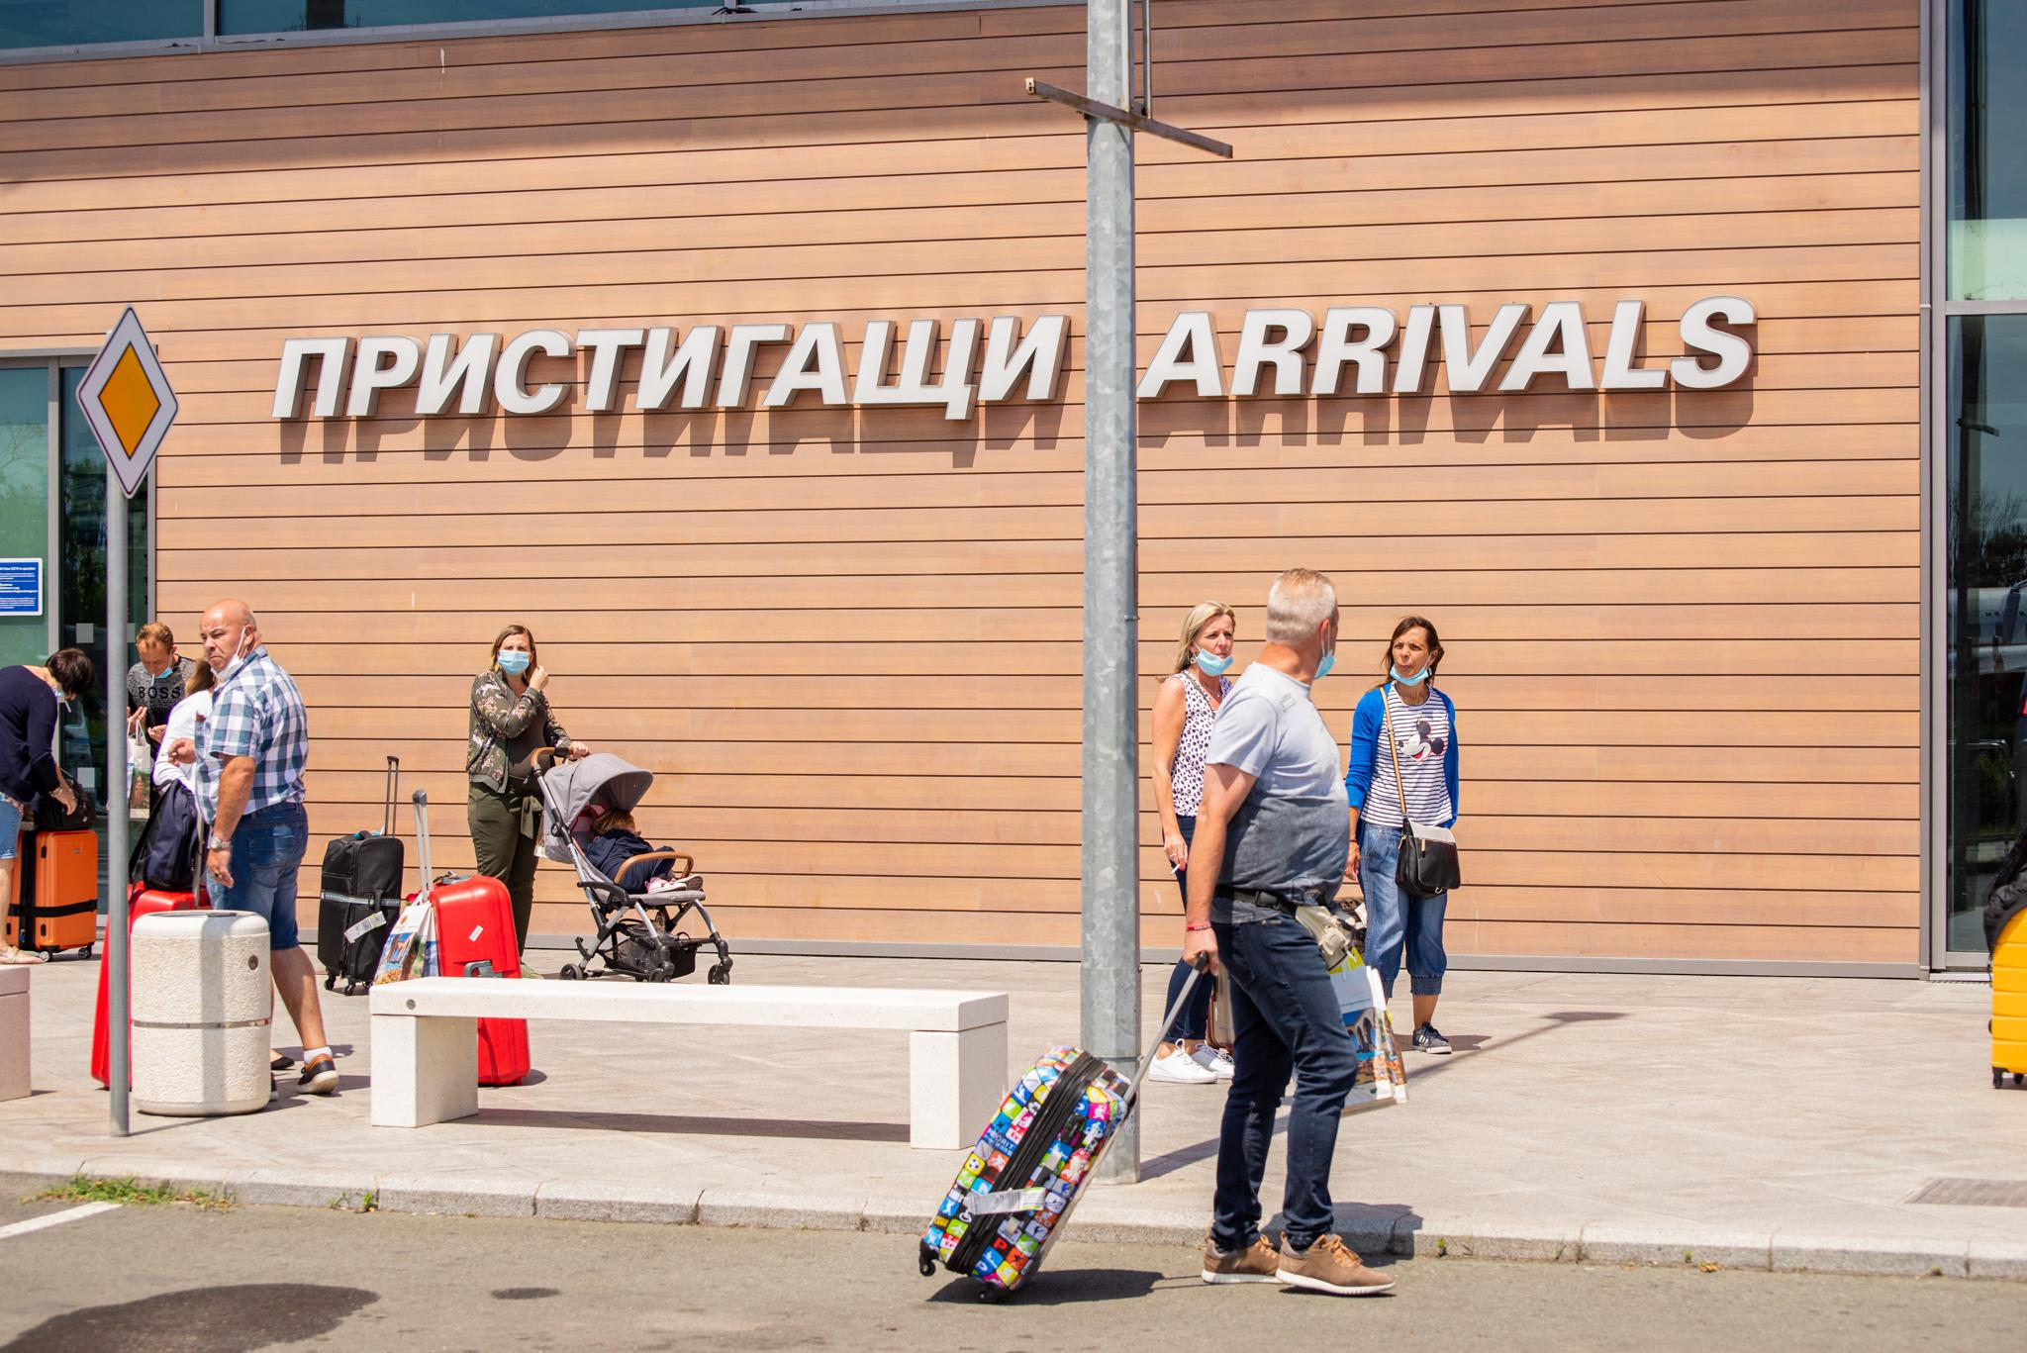
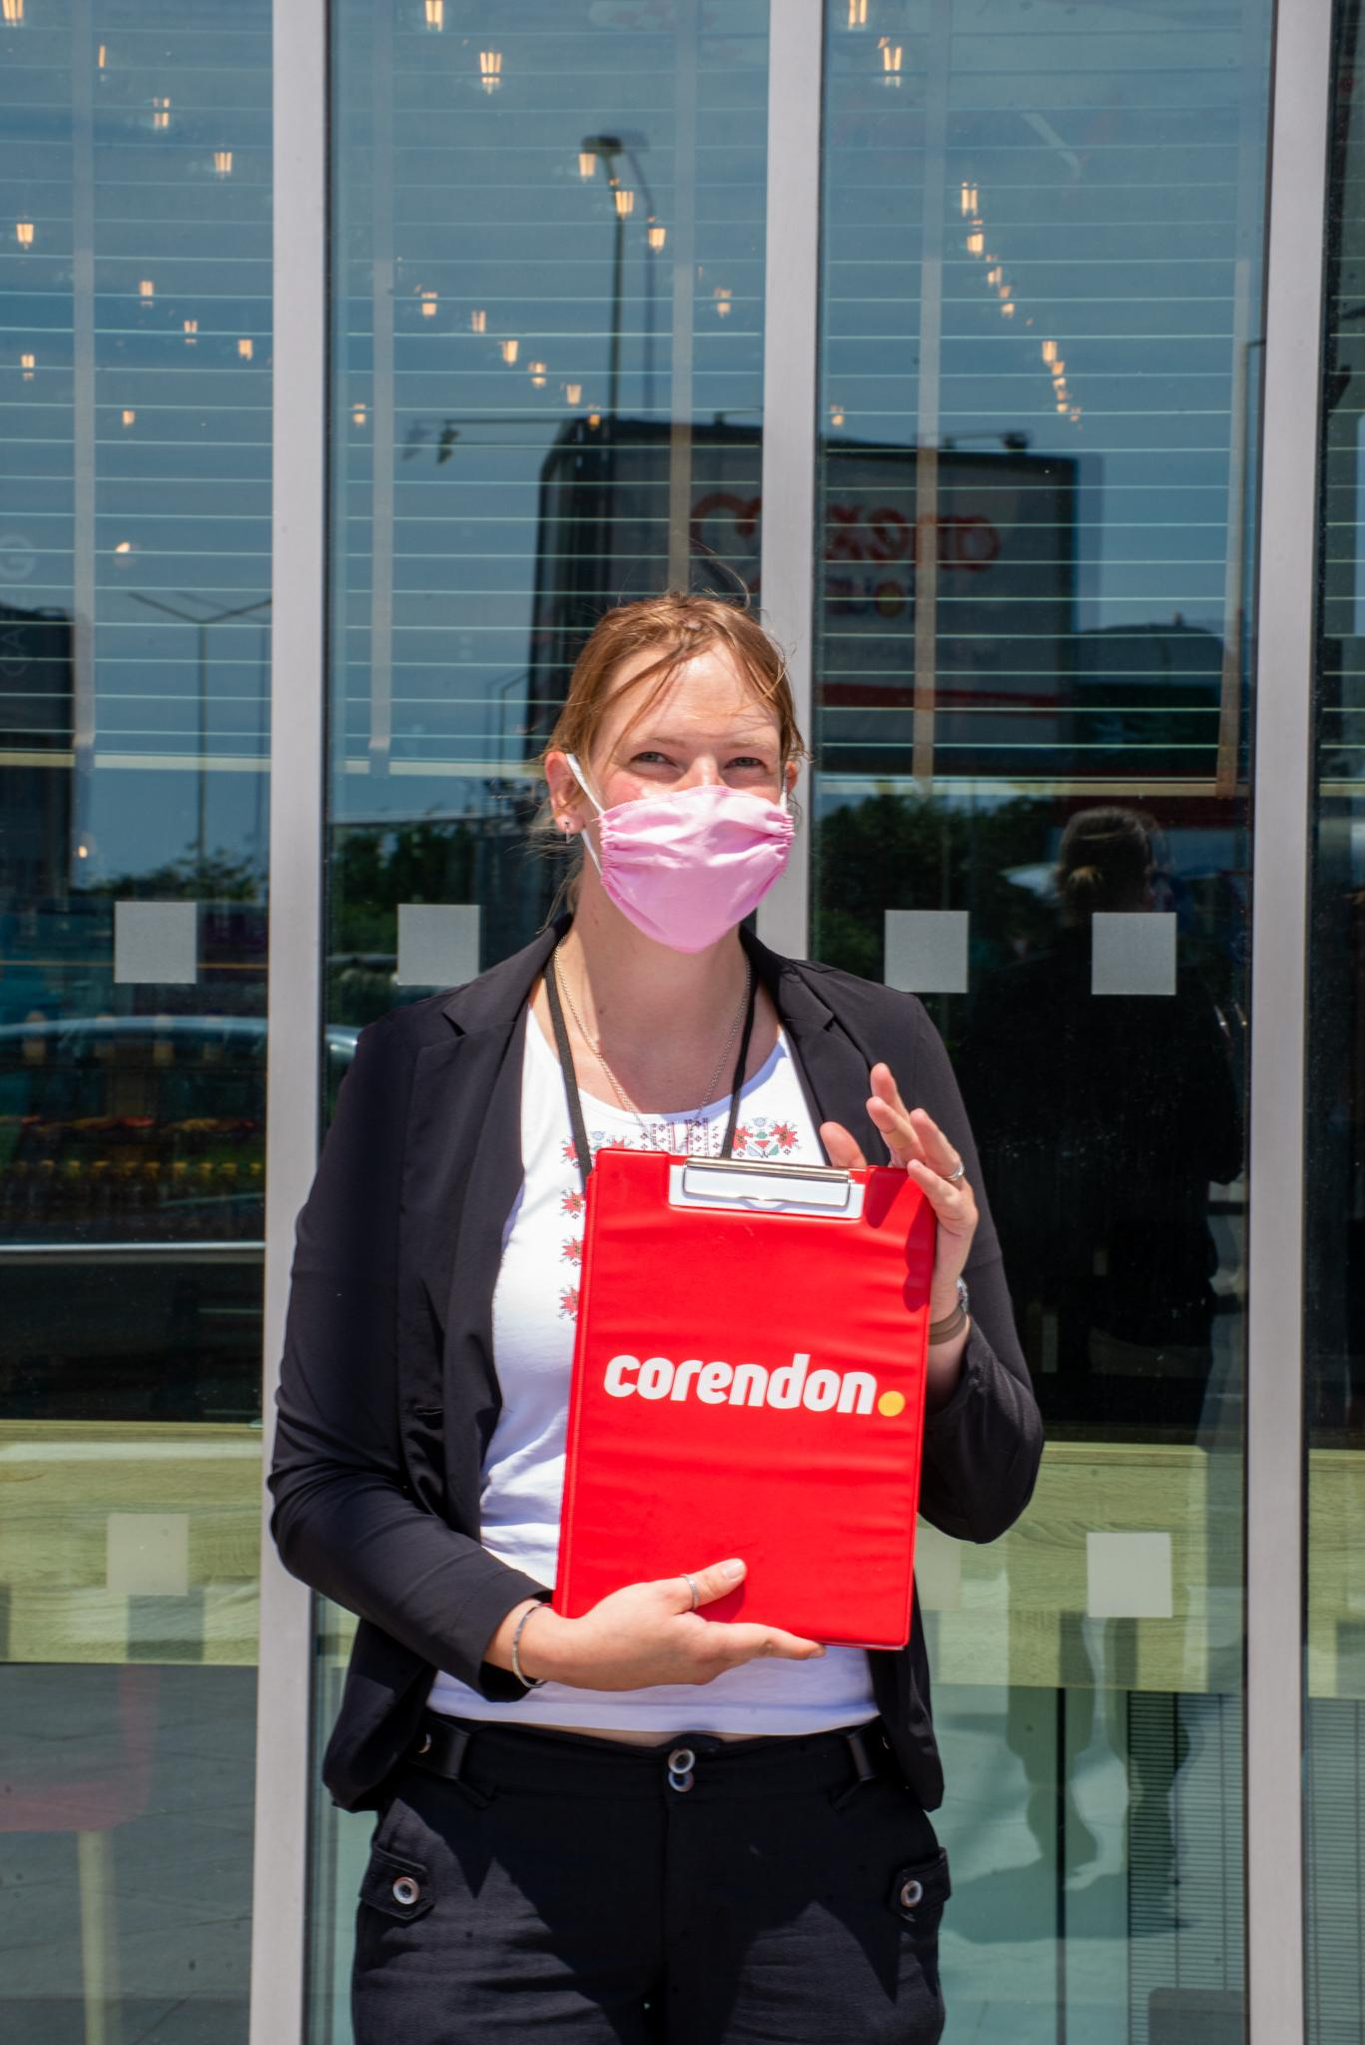
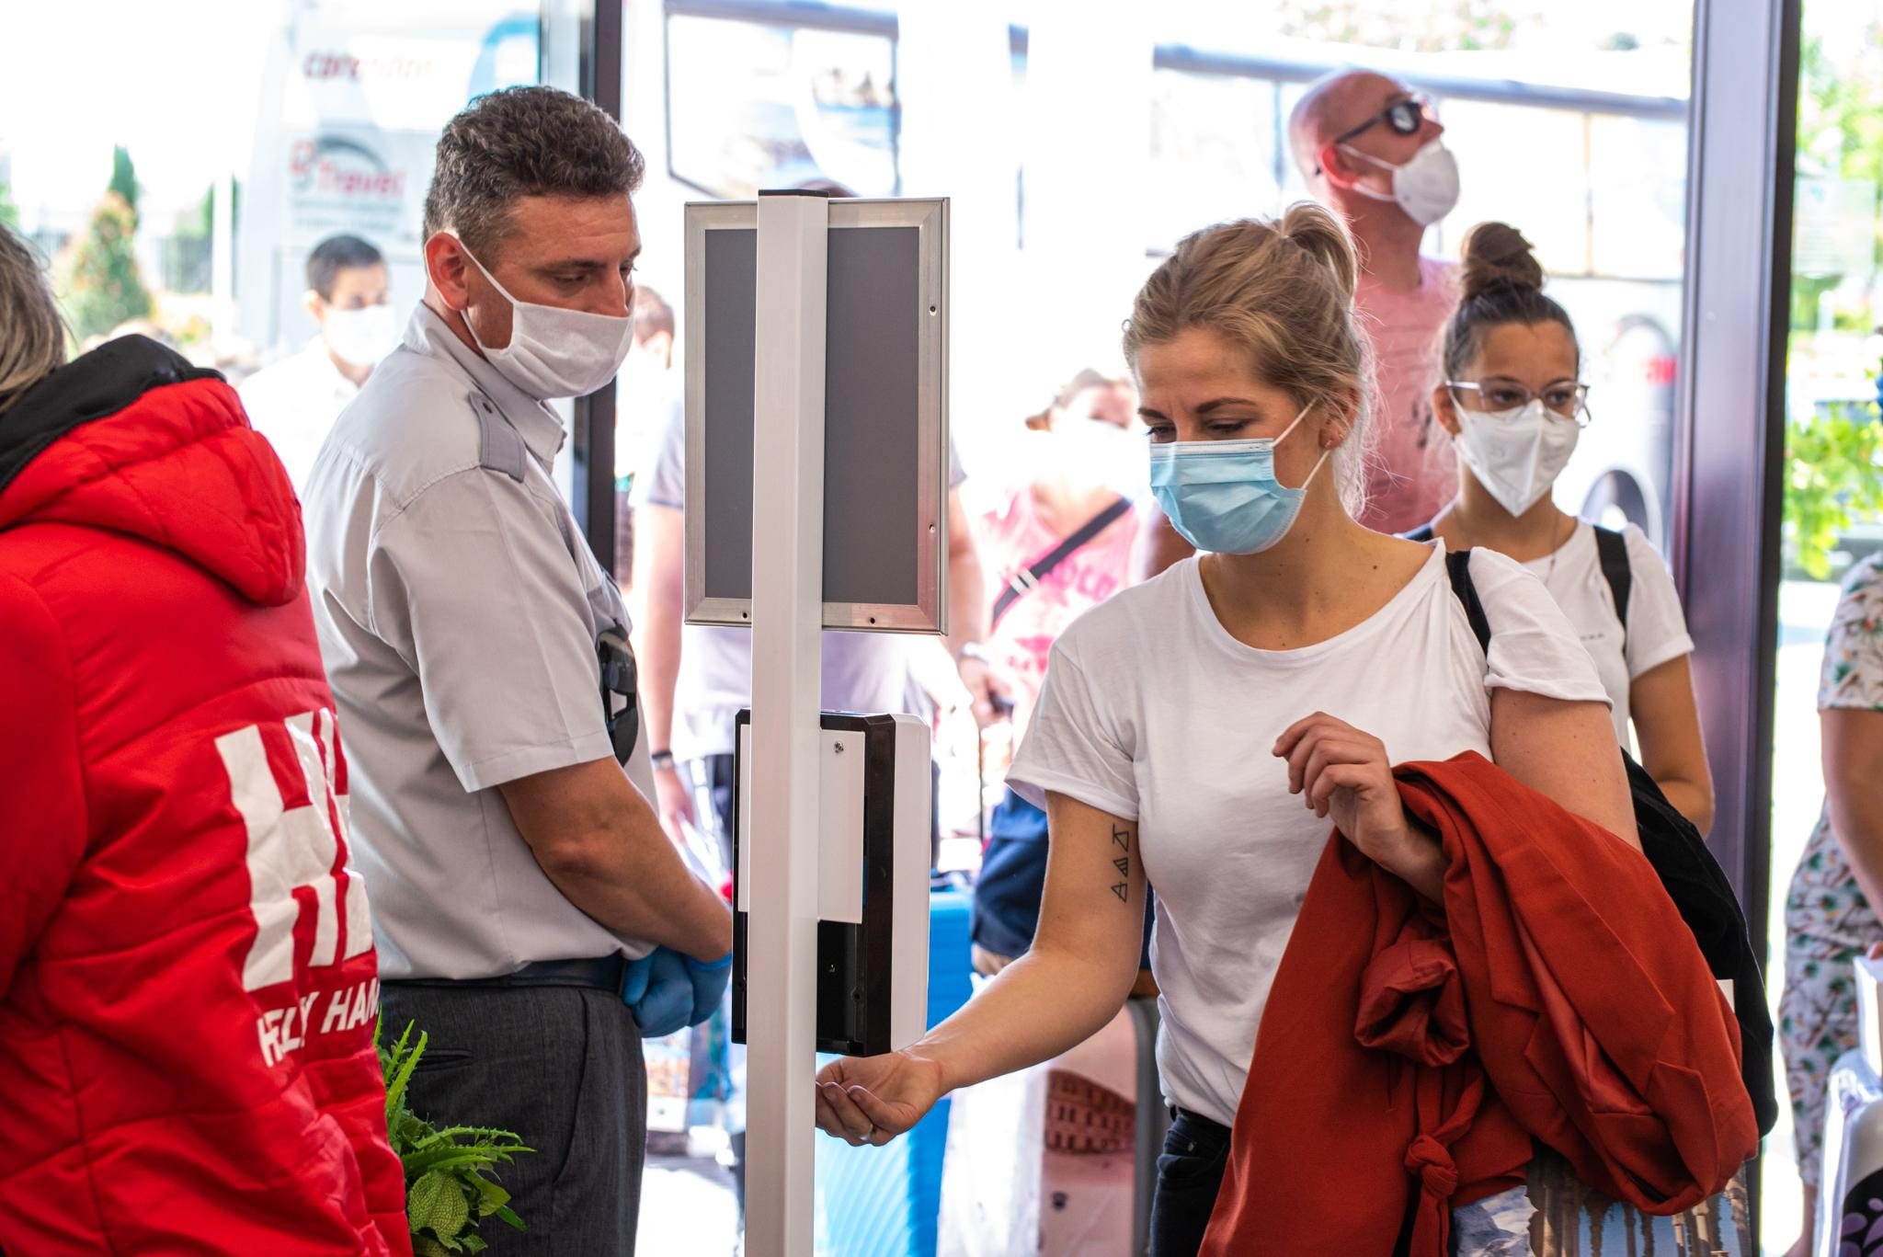
COVID-19 measures, safety and changes in our products and services
We took all the necessary actions to protect the health and wellbeing of both our customers and staff.
These measures are aimed at eliminating or reducing the possible viral load and include the following:
-Buses’ maximum capacity reduced by 30%
-Our hotels follow strict safety measures
-Mass excursions are cancelled
-Our focus is on trips for small groups
-New products with 1 on 1 car trips
AVATAR TOUR LTD website: www.avatartour.bg, e-mail: incoming@avatartour.bg

Slide 11
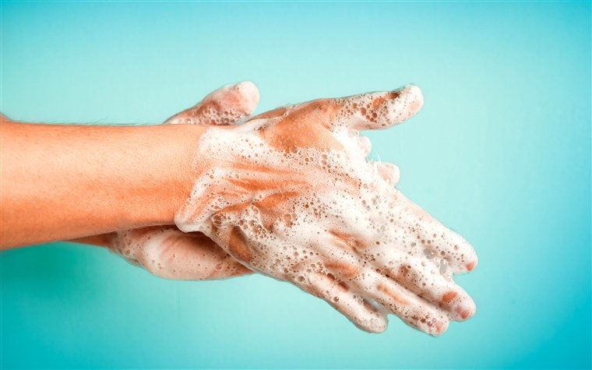

Safety advice and recommendation for all our tourists arriving in Bulgaria
We encourage all visitors in our country to strictly follow simple procedures to protect themselves and others from possible infection
This is easily achieved by the following:
-Constantly washing their hands
-Use sanitizers provided in public areas and hotels
-Wear masks in crowded areas
-Keep a safe distance
-Cover your cough or sneeze
AVATAR TOUR LTD website: www.avatartour.bg, e-mail: incoming@avatartour.bg

Slide 12
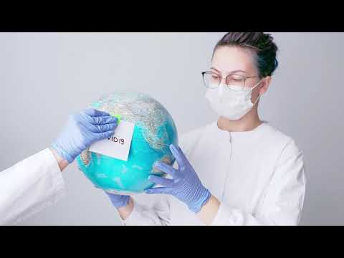
Measures taken against COVID-19 in Bulgaria
AVATAR TOUR LTD website: www.avatartour.bg, e-mail: incoming@avatartour.bg

Slide 13
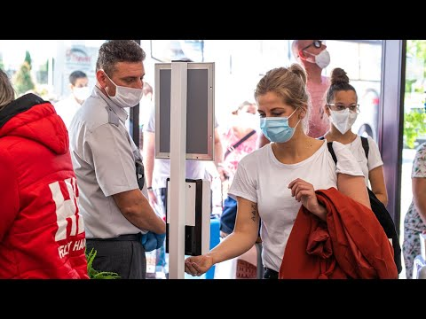
Measures taken against COVID-19 at Aqua Paradise Resort , Bulgaria
AVATAR TOUR LTD website: www.avatartour.bg, e-mail: incoming@avatartour.bg

Slide 14
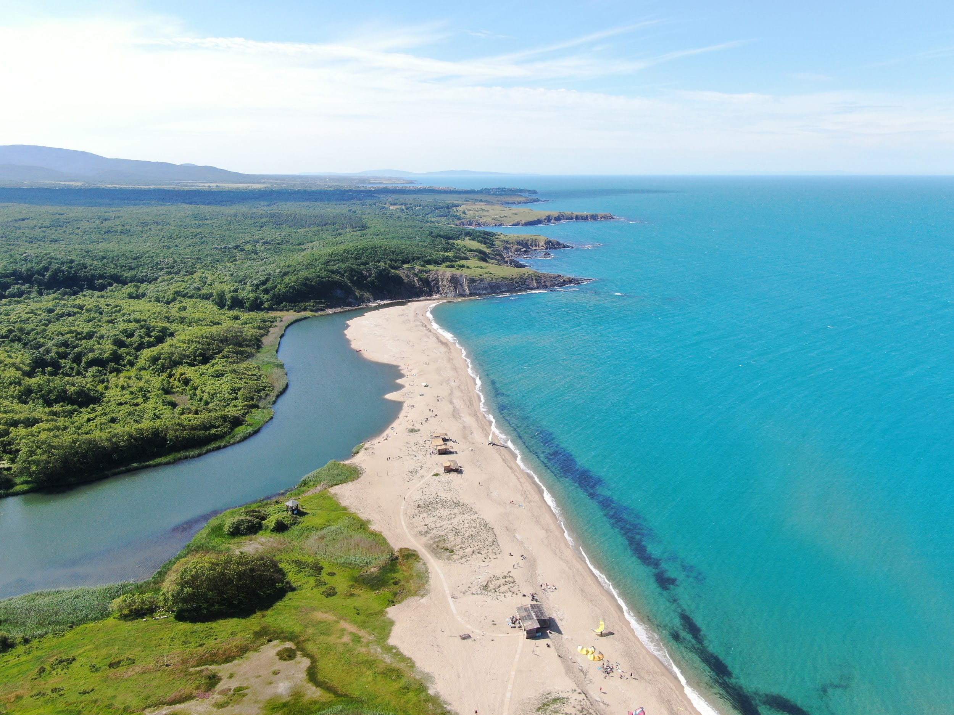
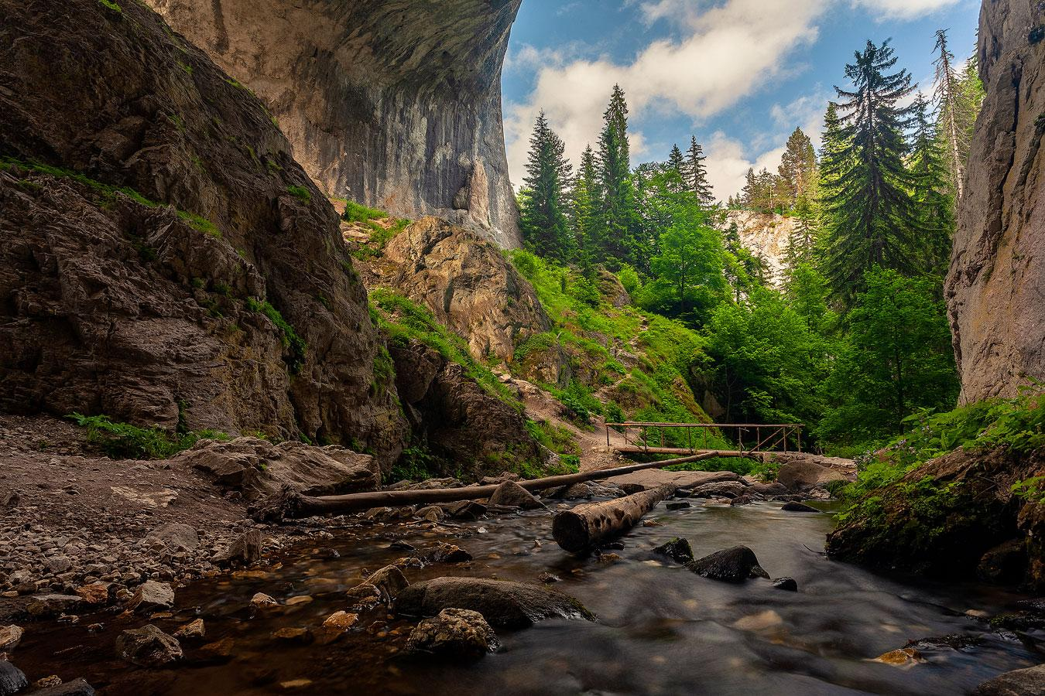
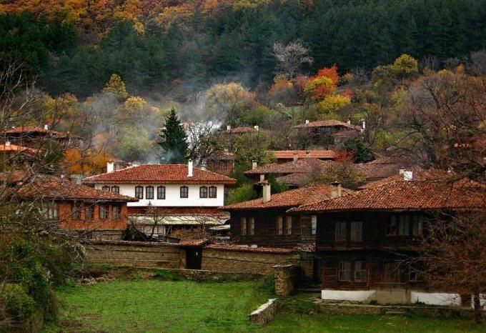
New “Bulgaria 1 on 1 by car” tours
across the country
Our newest product emphasizes on individual trips by car across the country. These trips will take you to some of the most fascinating places and will allow you to discover the beauty and diversity of Bulgarian nature as well as plenty of time for relaxation. Some of the highlights of this excursion are the folloiwng;
-You are in control of the journey
-Well detailed map with navigation and audio guide
-Safe travel for you and your family
-Discover hidden gems known by the locals only
-Worryless details for restaurants, parkings, hotspots and more
-Free tips and tricks and 24/7 support from our team
AVATAR TOUR LTD website: www.avatartour.bg, e-mail: incoming@avatartour.bg

Slide 15
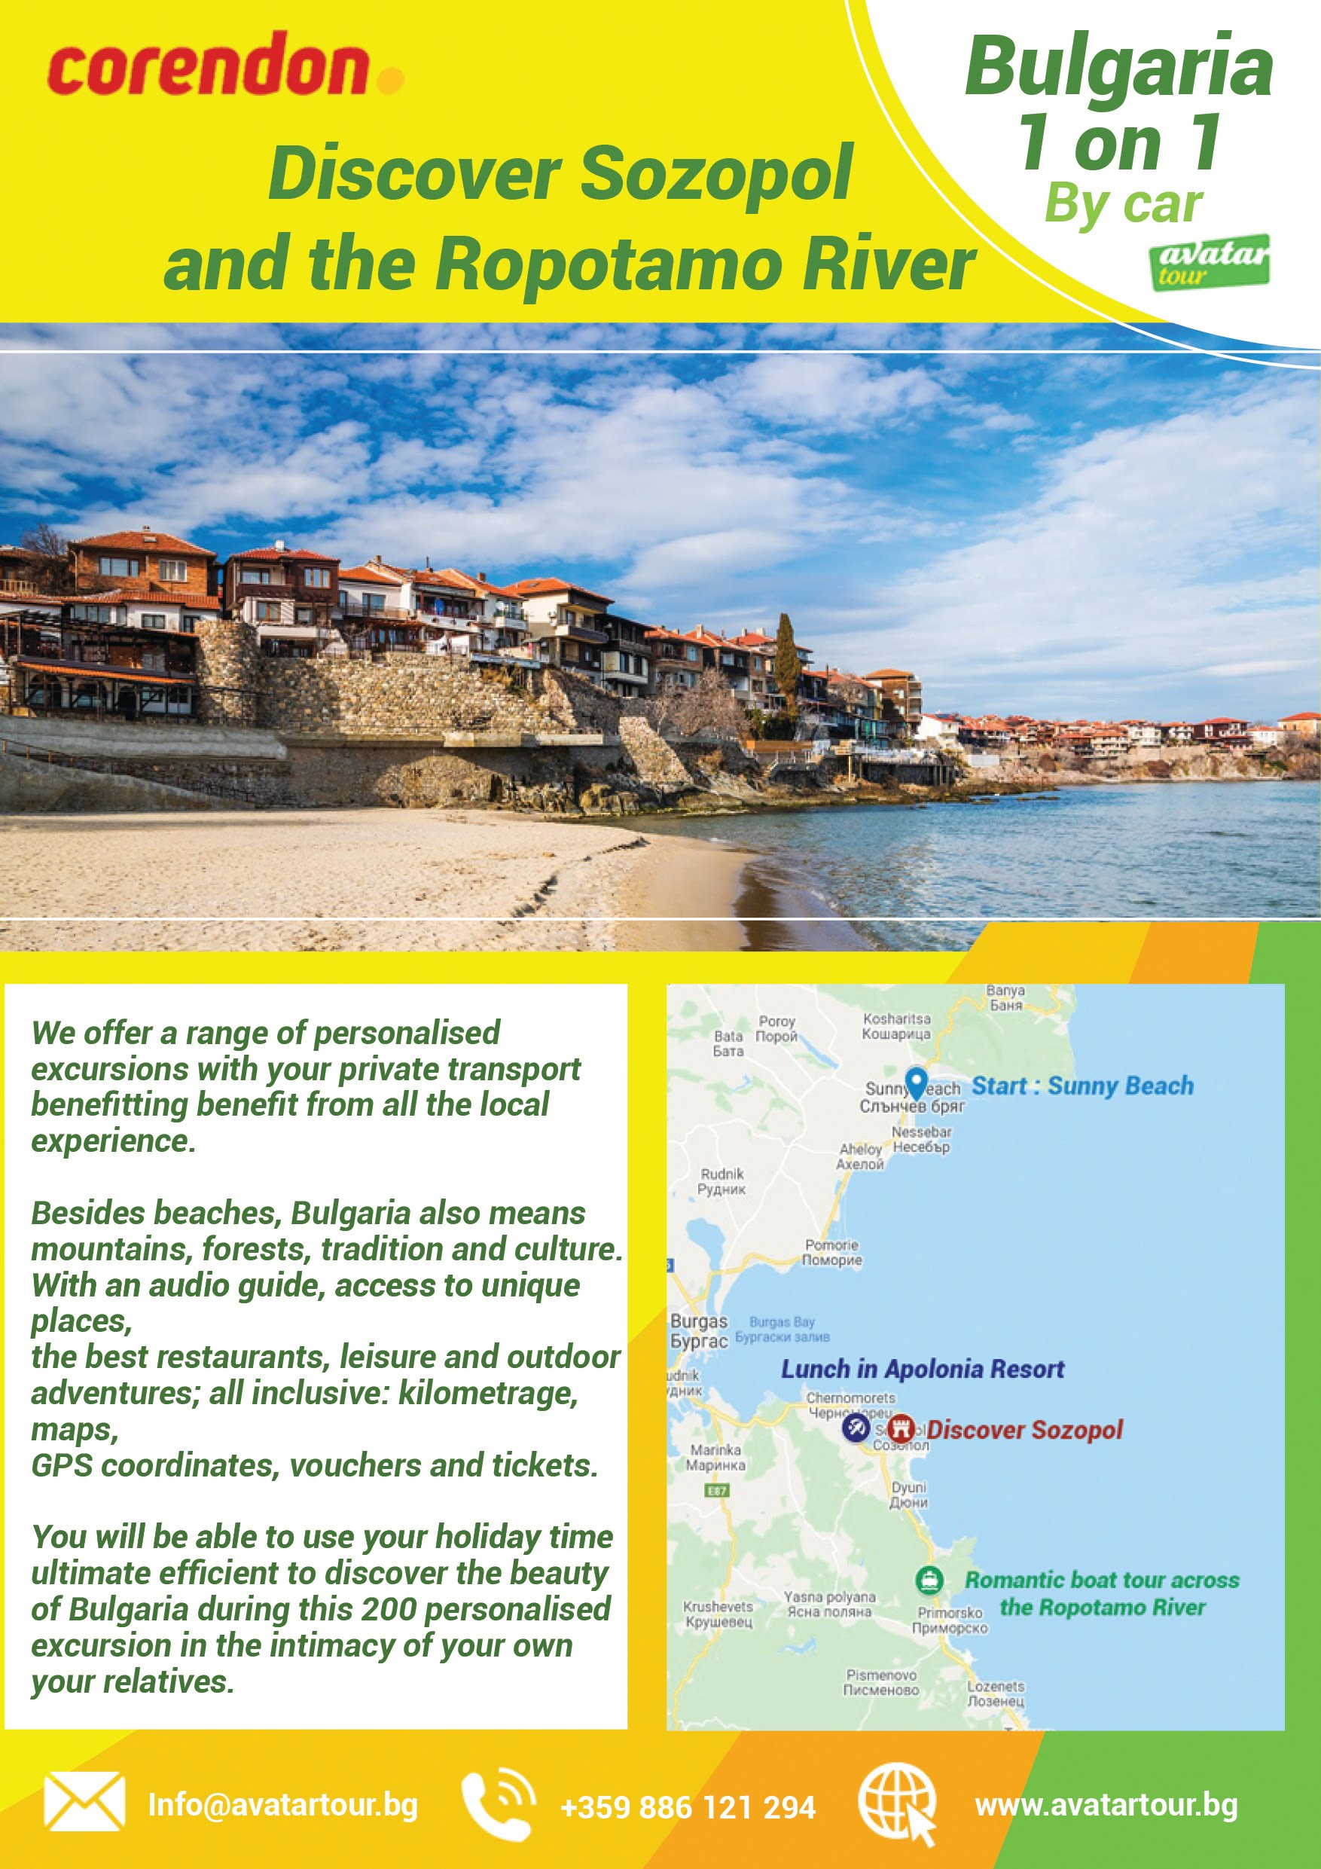
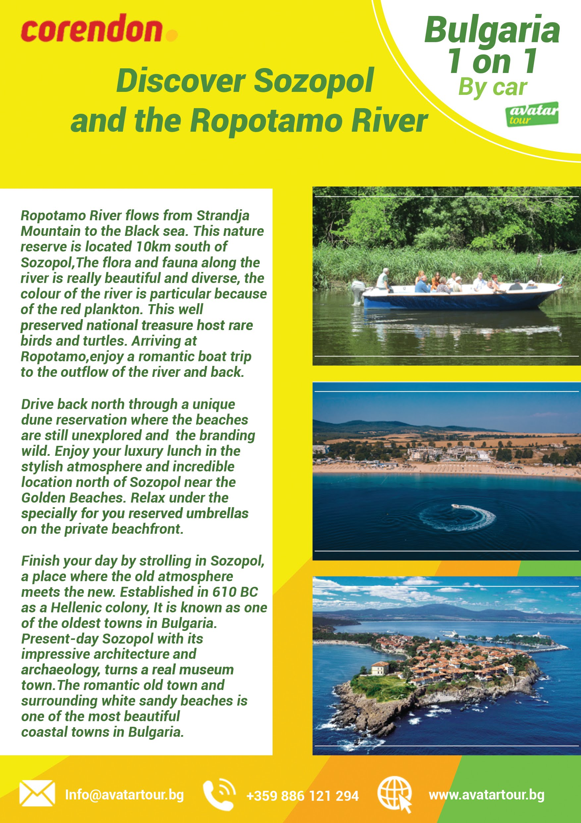
Sample materials:
AVATAR TOUR LTD

Slide 16
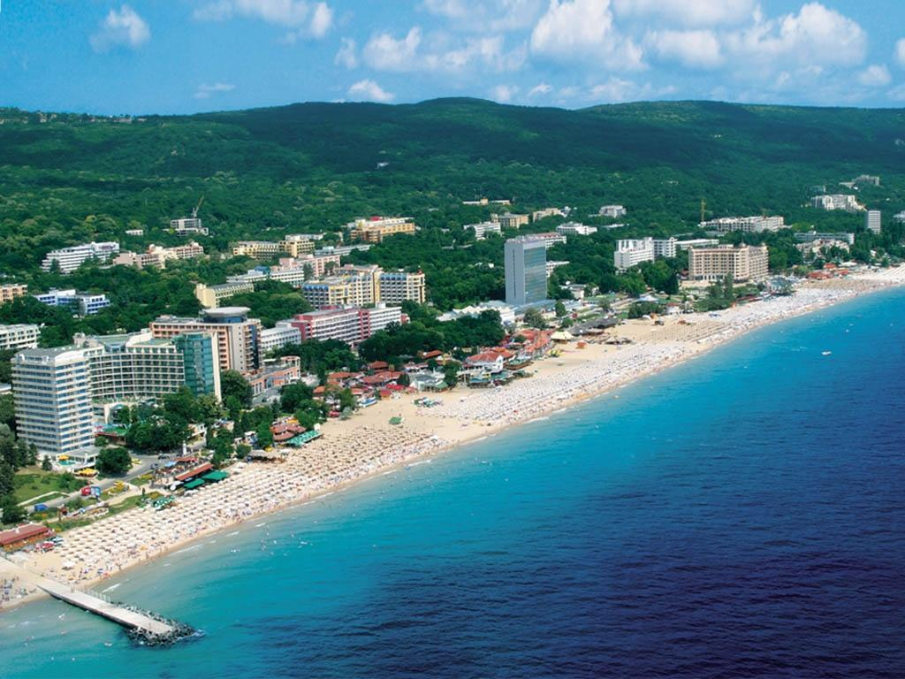
Our contracting managers obtain the best rates for our partners. We have an excellent business relationship and signed contracts with allotments and guaranteed rooms in over 250 hotels in Bulgaria.
AVATAR TOUR LTD website: www.avatartour.bg, e-mail: incoming@avatartour.bg

Slide 17
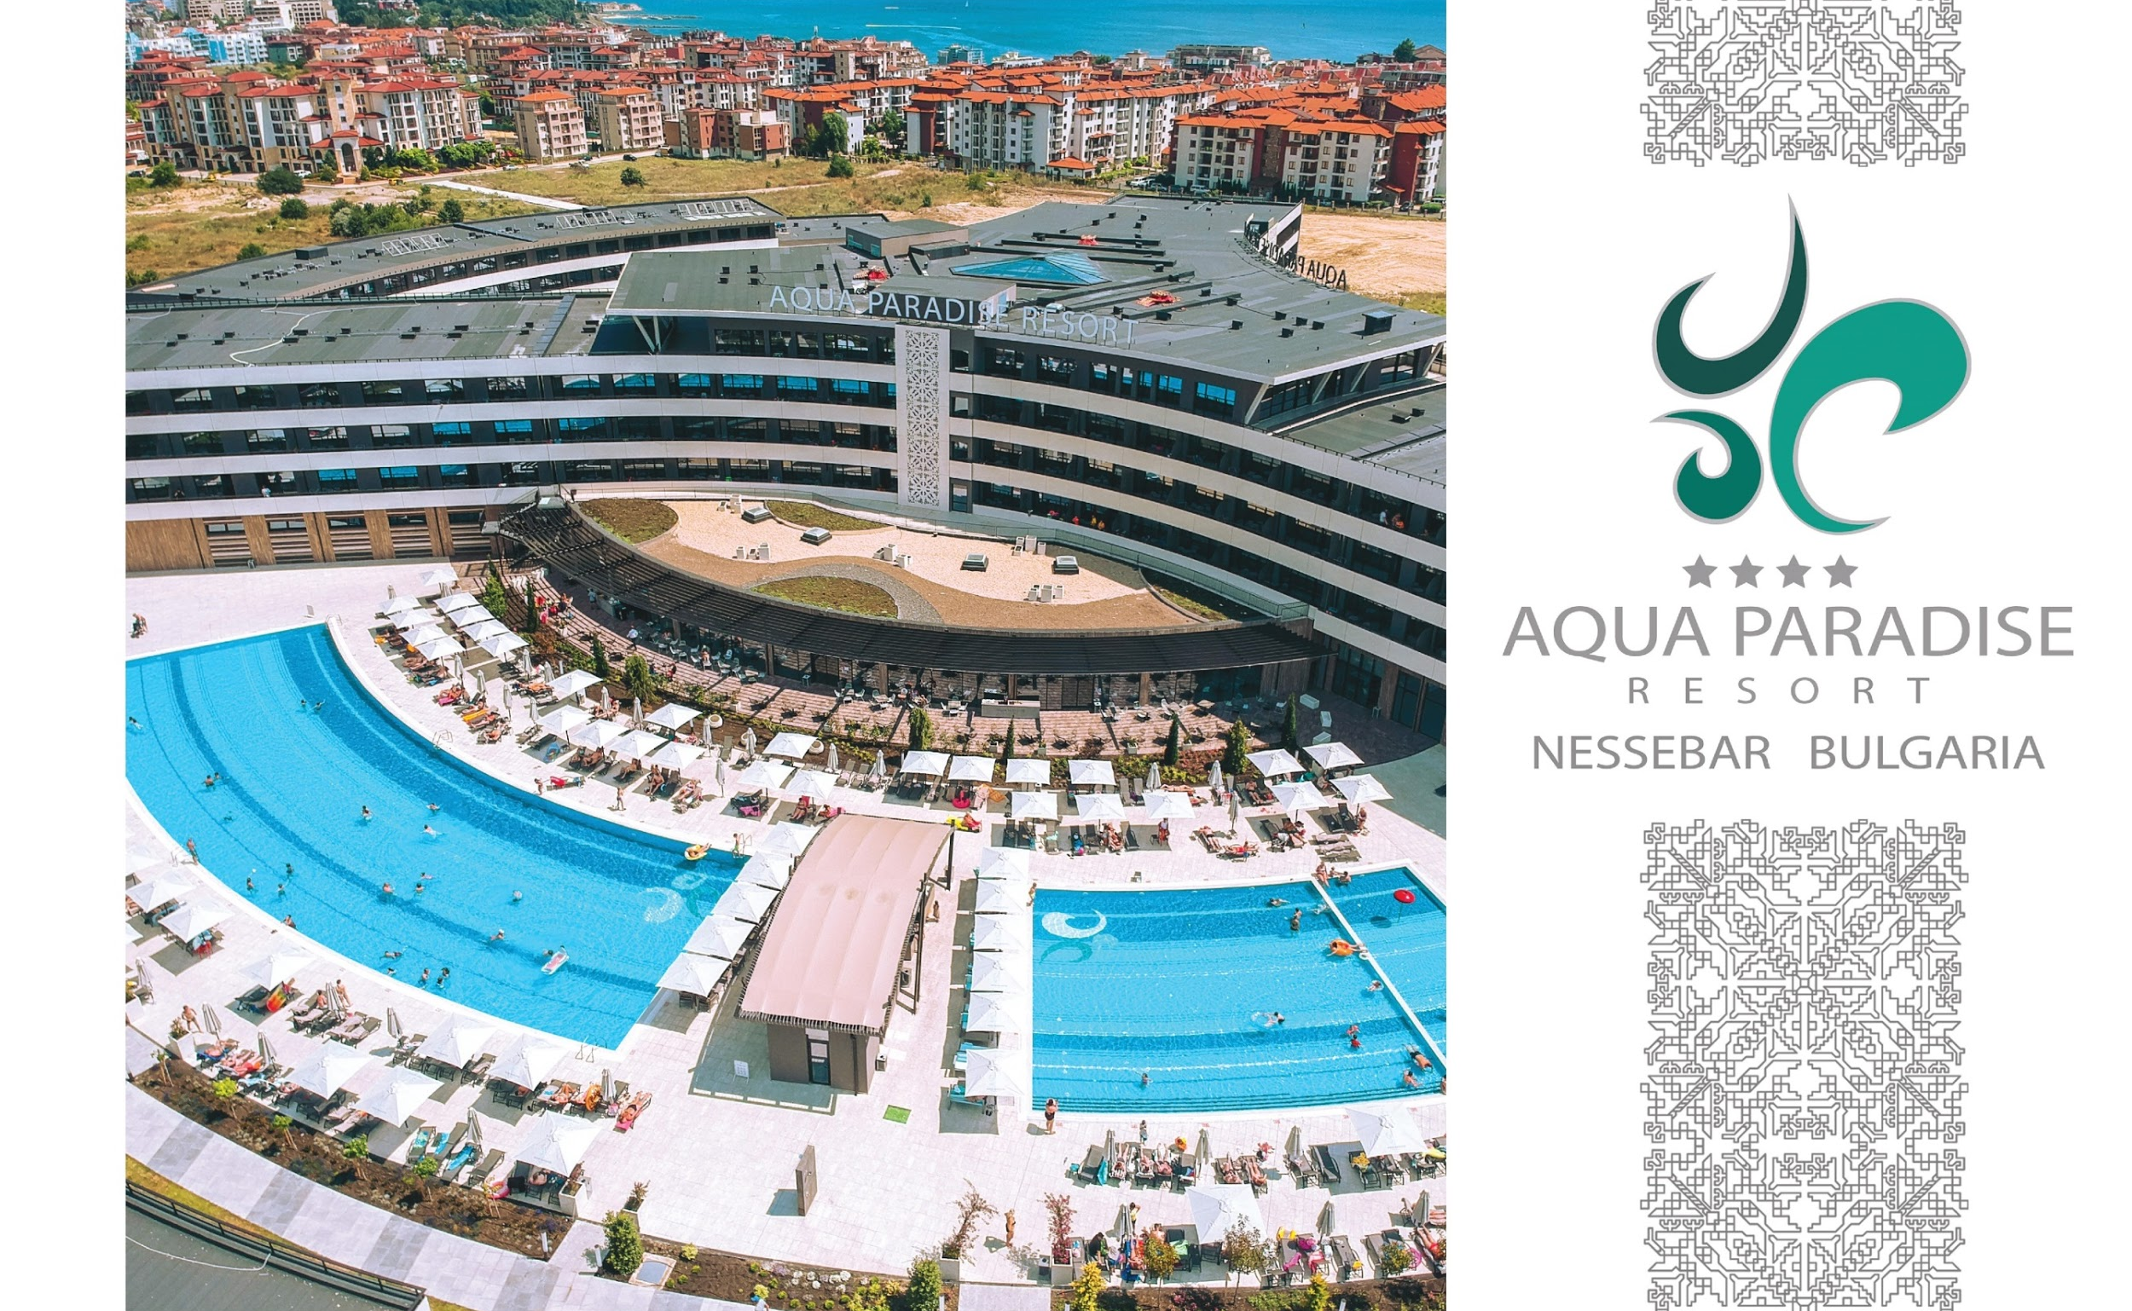
Avatar Tour is commercial branding and financial manager of one of the newest hotel complexes on the Bulgarian Black Sea Coast. Aqua Paradise Resort is an exclusive hotel complex, part of which is the largest waterpark on the Balkans- “Aqua Paradise-Nessebar”.
website: www.aquaparadiseresort.bg

Slide 18
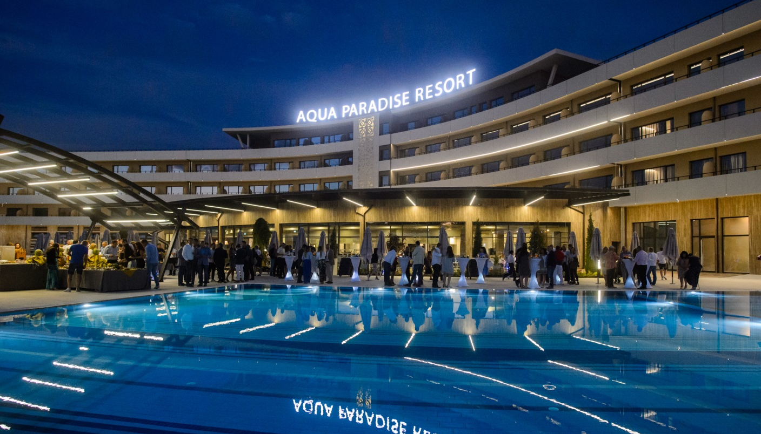
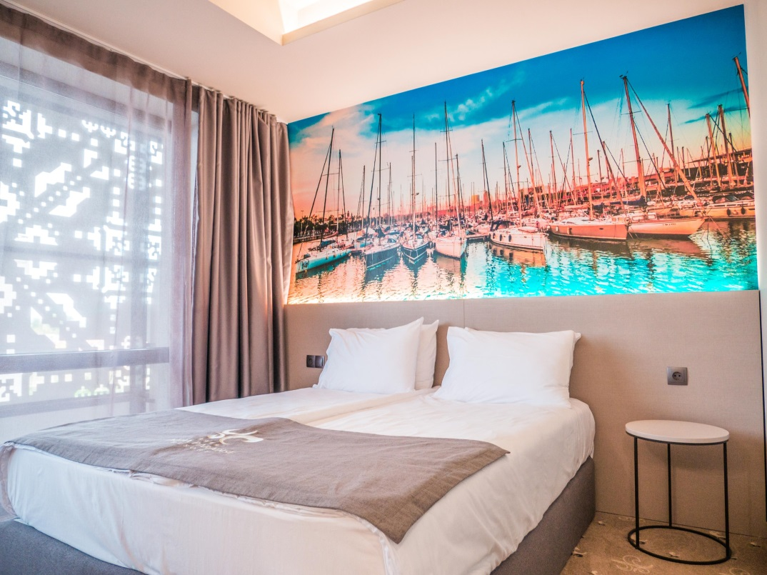
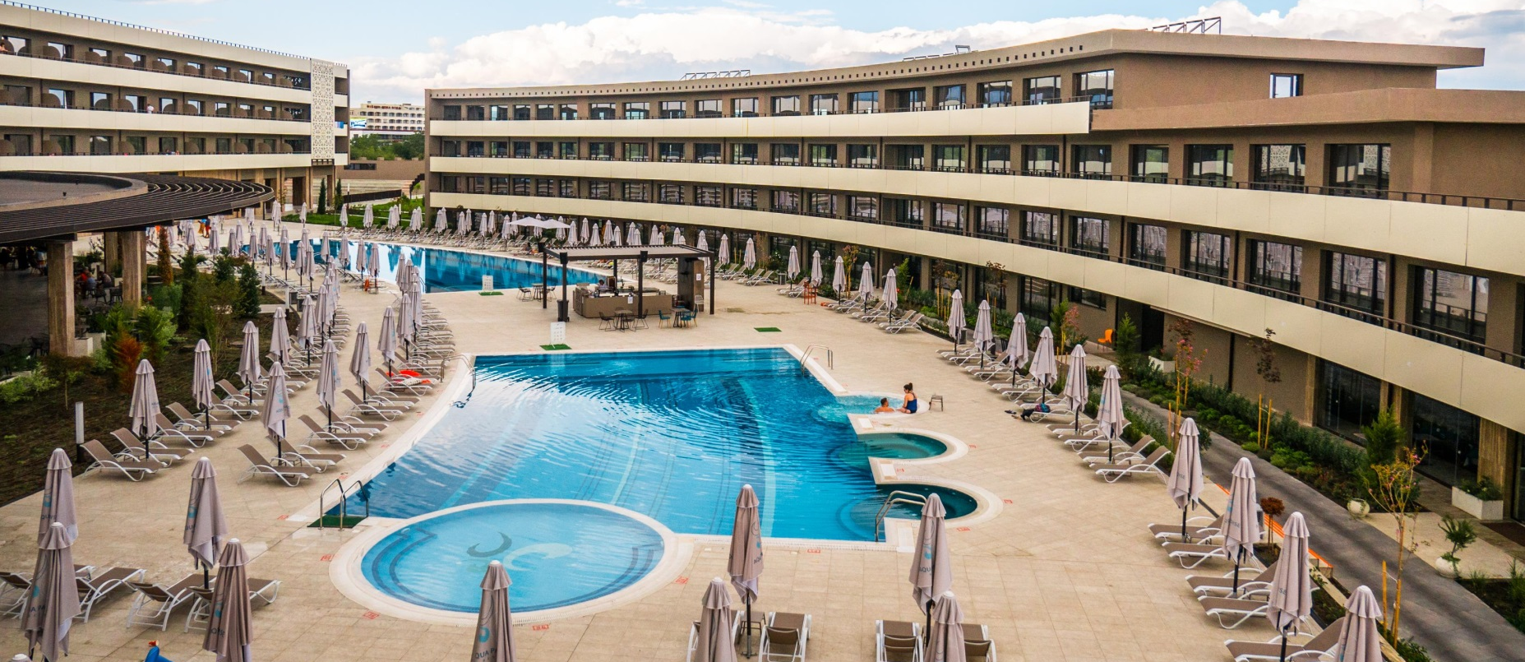
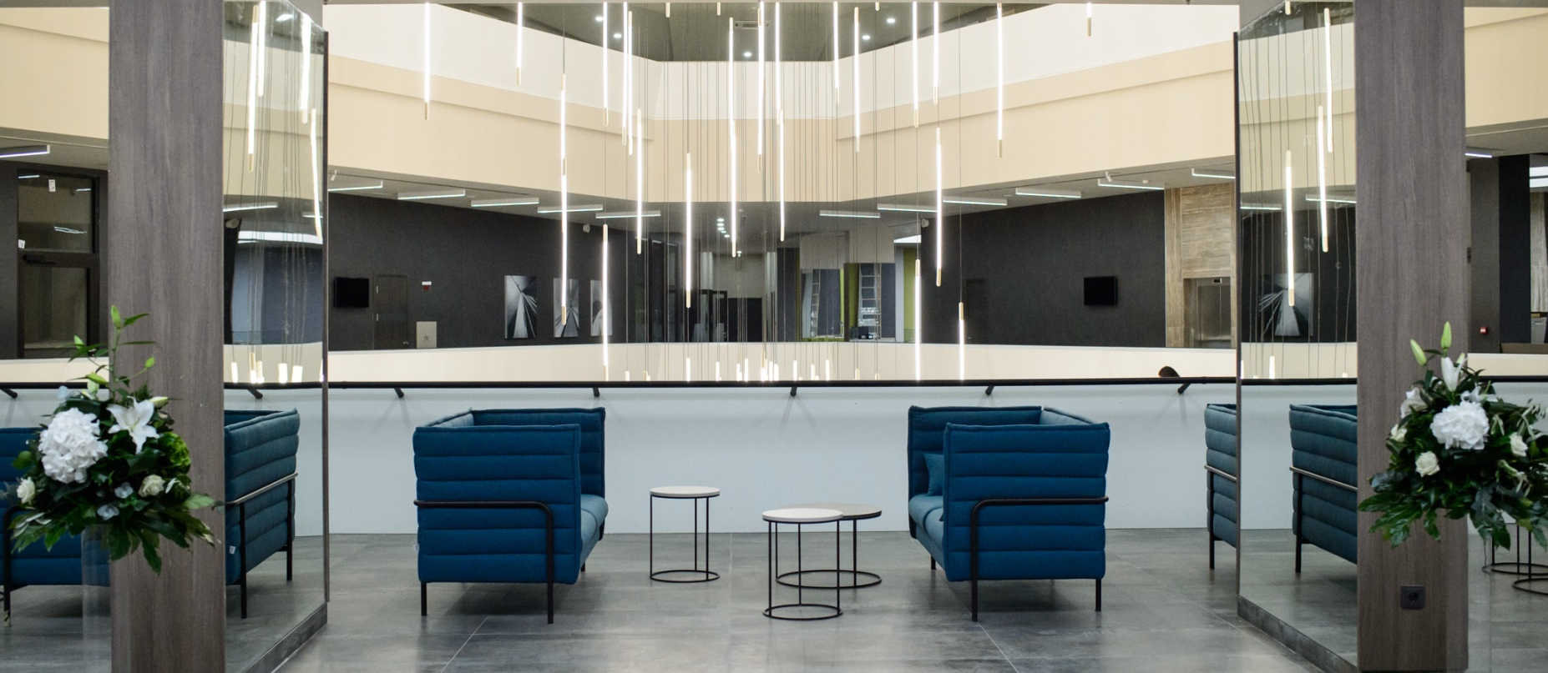
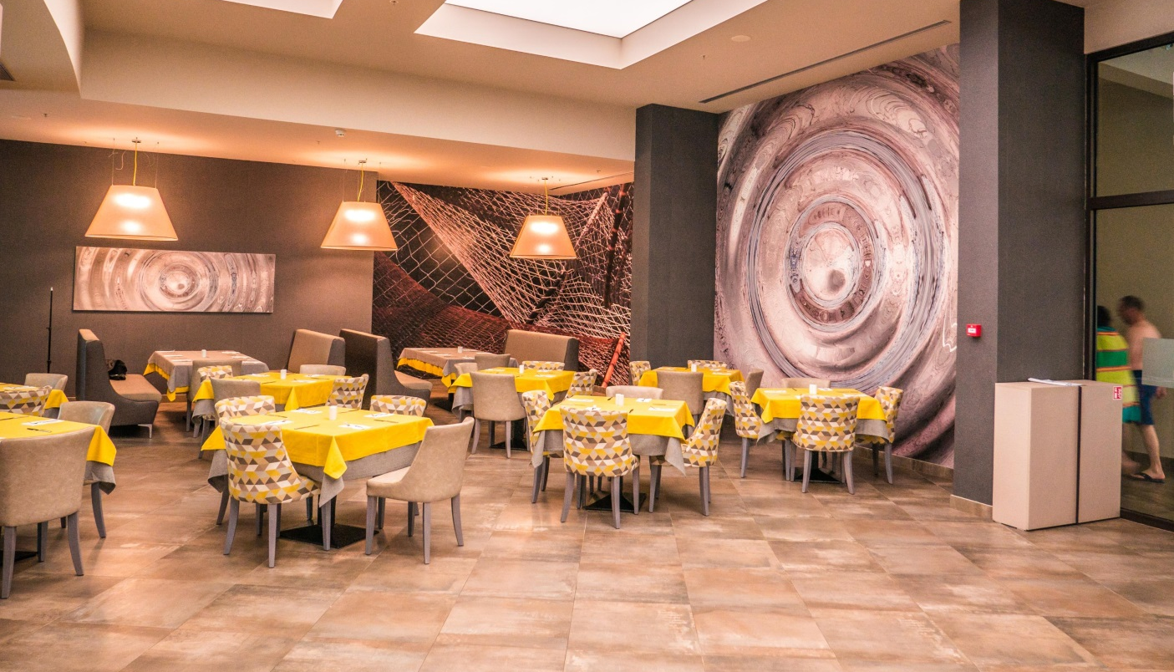

Slide 19
We pay great attention to technology: our partners benefit from our B2B system which works directly with our internal database and system. They can easily access all our opened for sale products and choose from many hotels in more than 30 regions in Bulgaria.
We can provide you with hotel pictures, fact sheets, AI concepts, etc. via our ftp server.
AVATAR TOUR LTD website: www.avatartour.bg, e-mail: incoming@avatartour.bg

Slide 20
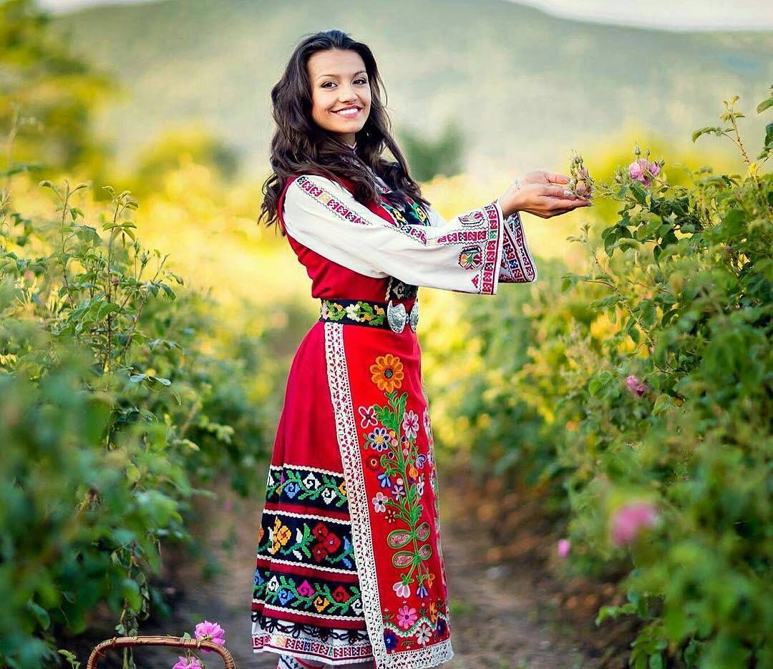
We will be honoured to service your clients in Bulgaria!
Thank you for your attention!

